Slide 2
OpenCelliD is BigData collection of Cell Towers and WiFi Aps. This database is built by the community and is free available for download. The row count is 39,374,666, Last updated on : 2018-02-14 Database link in CSV format https://opencellid.org/downloads

Slide 3
DataBase

Slide 4
Data Base Structure
Field | Description (based on official documentation where available)
ID | This field is auto Incremented.
Radio | UMTS/ GSM /LTE
Area | Location Area Code
Cell | Cell ID represents the ID of Cell for which you want to display the data.
Range | Estimated Range of the cell in meters
Samples | Total number of readings taken from that cell tower
Latitude | GPS latitude of the measurement
Longitude | GPS longitude of the measurement
Mcc | Mobile Country Code
Mnc | Mobile Network Code
Created | Date the Cell tower was added
Updated | Date the Measurement is Updated

Slide 5
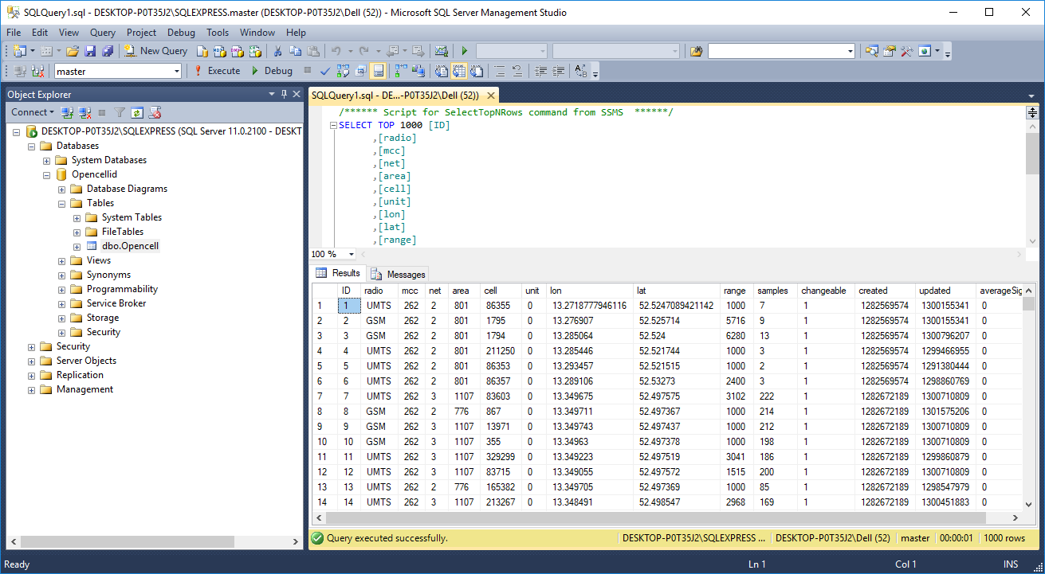
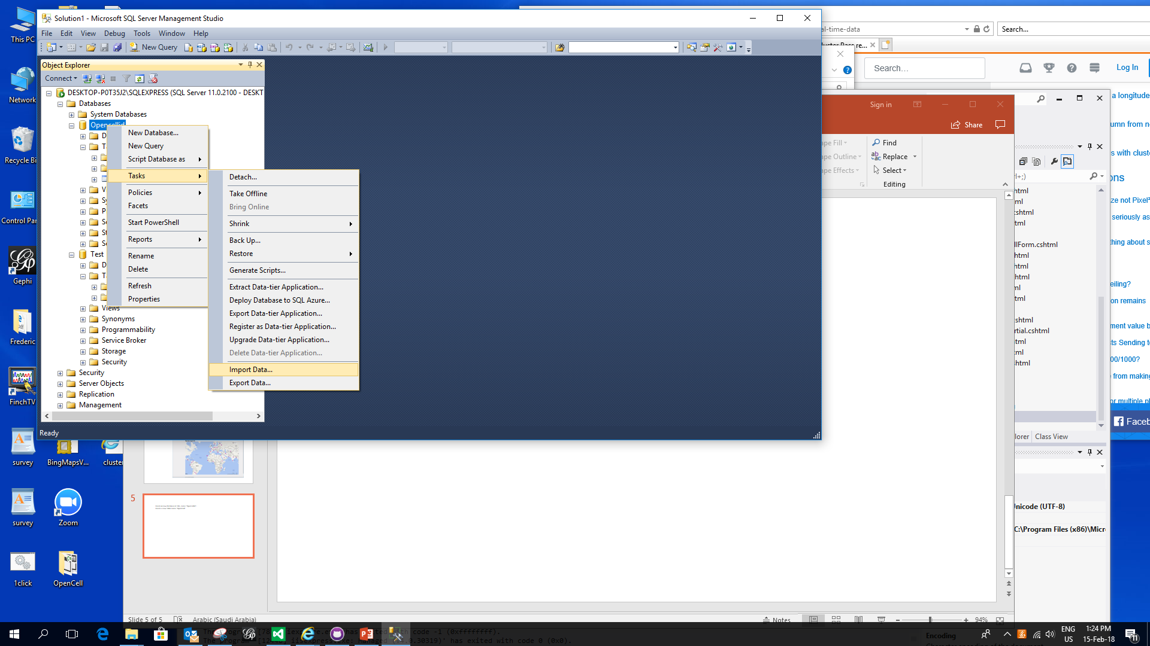
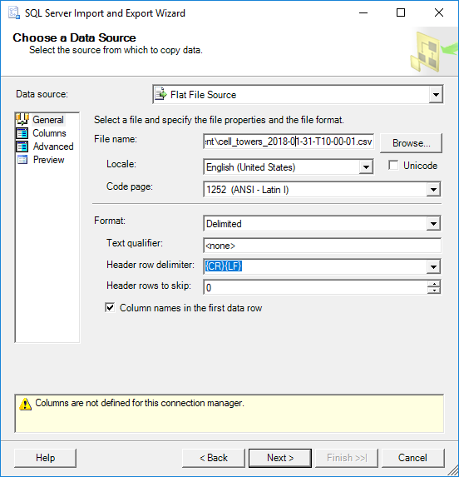
Import CSV in SQL Server
Import
Configuration
Query

Slide 6
Application

Slide 7
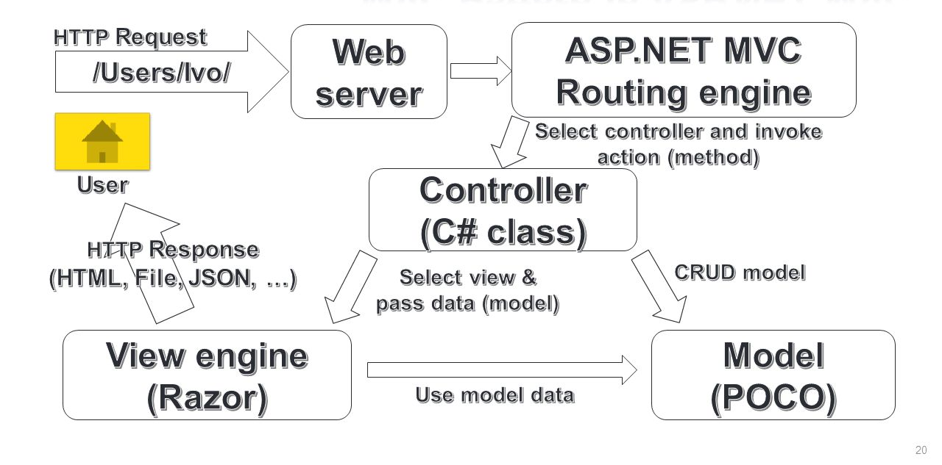
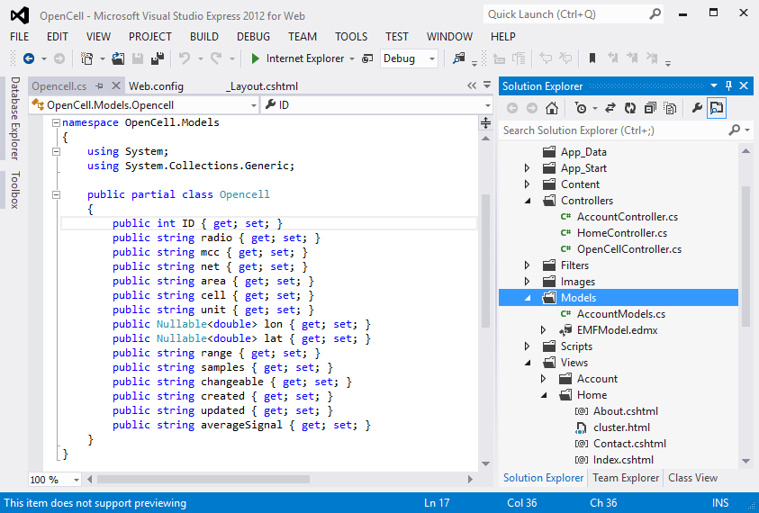
Model View Controller (MVC)
Controllers
Model
View

Slide 8
Bing MAP V8 API
Shared -> _Layout.cshtml
<script type='text/javascript' src='https://www.bing.com/api/maps/mapcontrol?branch=experimental&key=KeyHere& callback=onMapLoaded' async defer></script>
Callback function
Bing Maps V8 API
Required for clustering
function onMapLoaded() {
var map = new Microsoft.Maps.Map(document.getElementById('theMap'), {
/* No need to set credentials if already passed in URL */
center: new Microsoft.Maps.Location(39.393486, -98.100769),
zoom: 3 });
Microsoft.Maps.loadModule('Microsoft.Maps.Clustering', function () {
// Creating sample Pushpin data within map view
var pins = [];
@foreach (var item in Model) {
<text>
var pin = new Microsoft.Maps.Pushpin(new Microsoft.Maps.Location(@item.lat, @item.lon));
pin.metedata = item;
pins.push(pin);
</text>
}
//var pushpins = Microsoft.Maps.TestDataGenerator.getPushpins(1000, map.getBounds());
var clusterLayer = new Microsoft.Maps.ClusterLayer(pins, { gridSize: 100 });
map.layers.insert(clusterLayer);
});
}
View -> _Index.cshtml
Loop to generate dynamic pins from the database
Call Clustering Function

Slide 9
OpenCell.js
MAP Function Scripts
OpenCell.LoadMap = function (latitude, longitude, onMapLoaded) {
OpenCell._map = new Microsoft.Maps.Map(document.getElementById('theMap'), {});
// Create draggable Pin in the center
var center = OpenCell._map.getCenter();
var Location = Microsoft.Maps.Location;
var Pushpin = Microsoft.Maps.Pushpin;
if (latitude != null && longitude != null) {
this._map.setView({
center: new Microsoft.Maps.Location(latitude, longitude),
zoom: 15
});
OpenCell._pins = new Pushpin(new Location(latitude, longitude), { color: '#00f', draggable: true });
}
else {
OpenCell._pins = new Pushpin(new Location(center.latitude, center.longitude), { color: '#00f', draggable: true });
}
OpenCell._map.entities.push(OpenCell._pins);
// Binding the events
OpenCell.EnableCallback();
}
OpenCell.LoadPins = function (latitude, longitude) {
OpenCell._map = new Microsoft.Maps.Map(document.getElementById('theMap'), {});
// Create draggable Pin in the center
var center = OpenCell._map.getCenter();
var Location = Microsoft.Maps.Location;
var Pushpin = Microsoft.Maps.Pushpin;
if (latitude != null && longitude != null) {
this._map.setView({
center: new Microsoft.Maps.Location(latitude, longitude),
zoom: 15
});
OpenCell._pins = new Pushpin(new Location(latitude, longitude), { color: '#00f', draggable: false });
}
else {
OpenCell._pins = new Pushpin(new Location(center.latitude, center.longitude), { color: '#00f', draggable: false });
}
OpenCell._map.entities.push(OpenCell._pins);
// Binding the events
//OpenCell.EnableCallback();
}
Events Handlers
OpenCell.EnableCallback = function () {
var Events = Microsoft.Maps.Events;
Events.addHandler(OpenCell._pins, 'drag', function (e) { onMouseUp(e); });
}
function onMouseUp(e) {
var loc = e.location;
$("#lat").val(loc.latitude.toString());
$("#lon").val(loc.longitude.toString());
}

Slide 10
Runtime

Slide 11
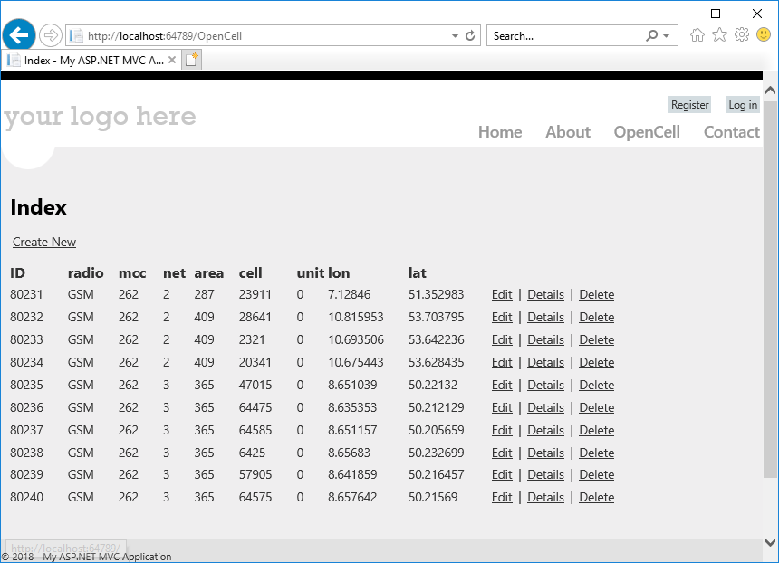
CRUD Functionality
List top 10 rows
OpenCell.Controllers
public ActionResult Index()
{
return View(db.Opencells.Where(x=>x.ID<=10).ToList());
}

Slide 12
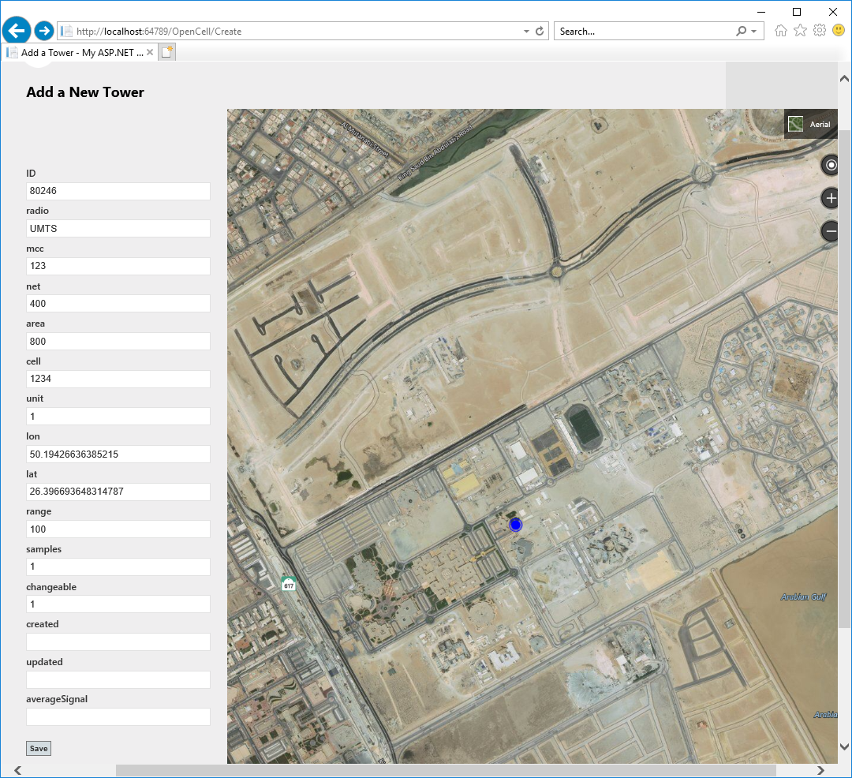
Create New
Dragging of Pin Auto updates Longitude and Latitude
New Draggable Pin
Save New Tower ID “80246”
In Database

Slide 13
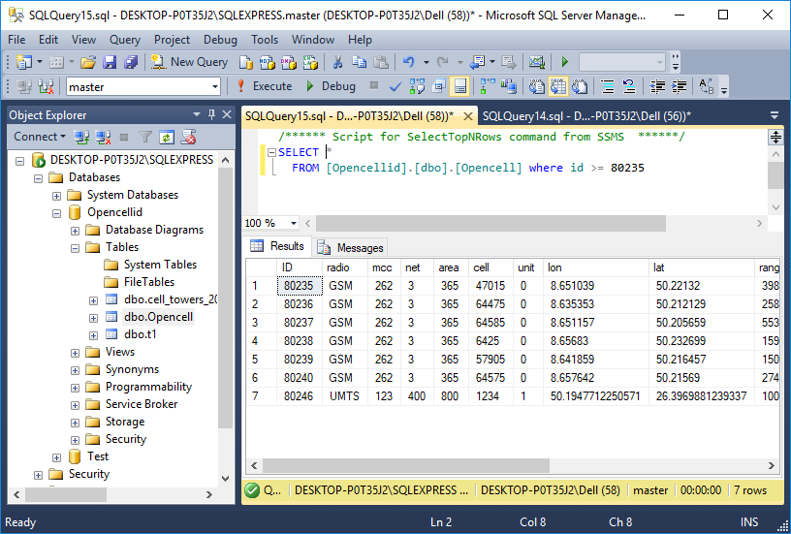
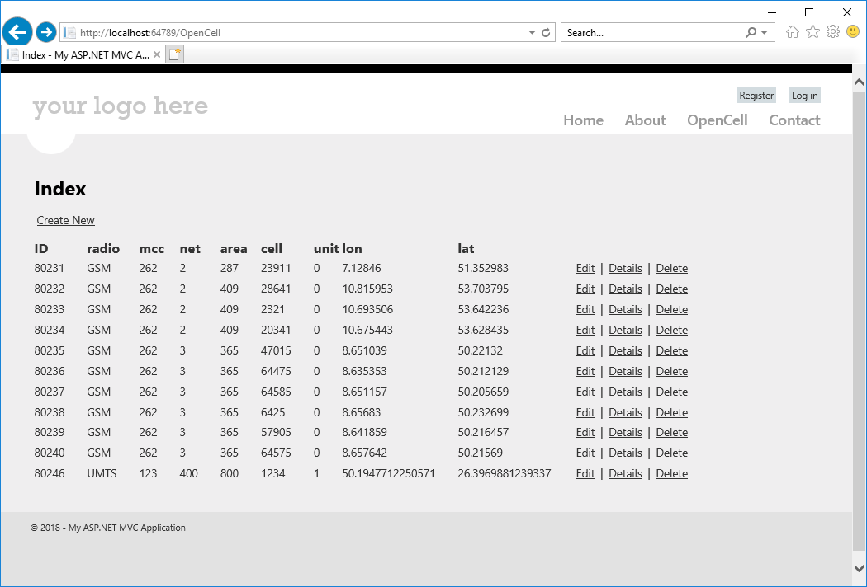
Locate New ID
New ID “80246”
In the Database
New ID “80246”
In the View

Slide 14
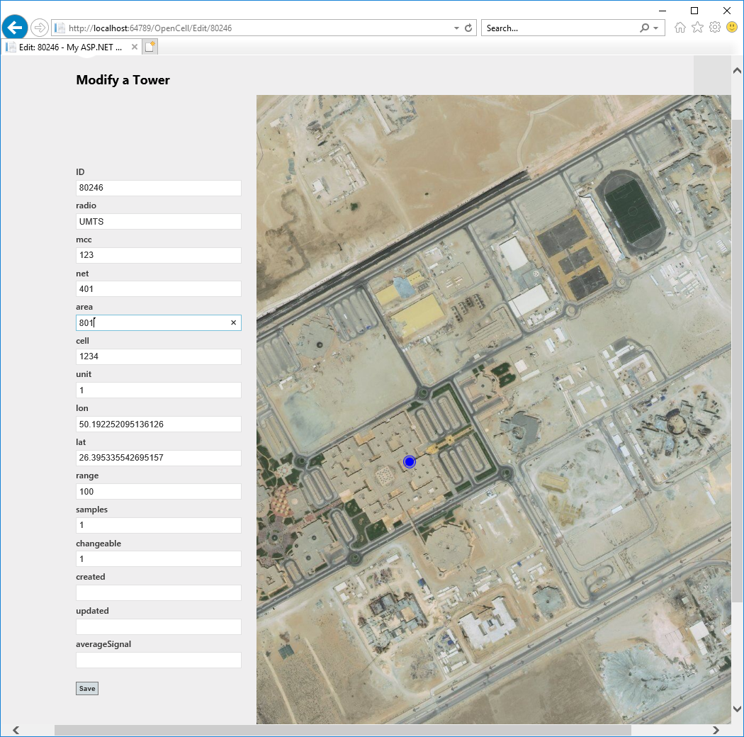
Modify the Location
Load Tower ID “80246”
From the Database
Drag the Pin to new Location to update new location
Update Tower ID “80246”
In the Database

Slide 15
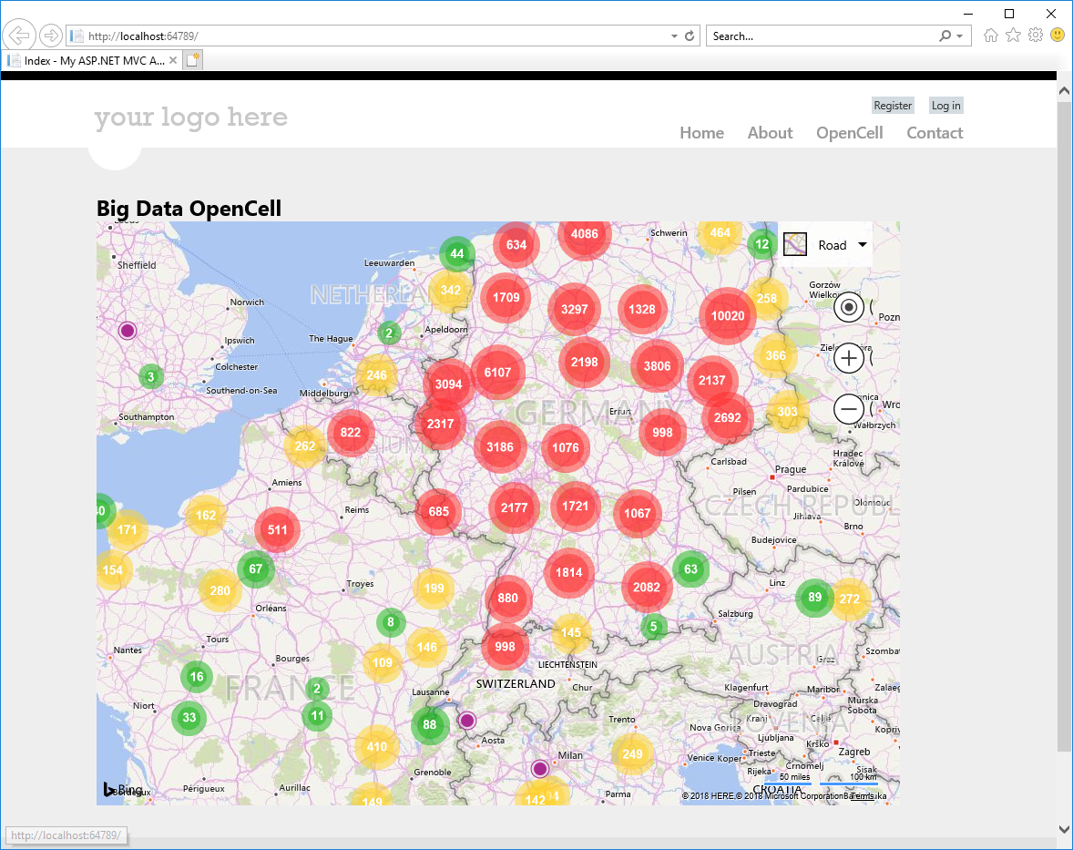
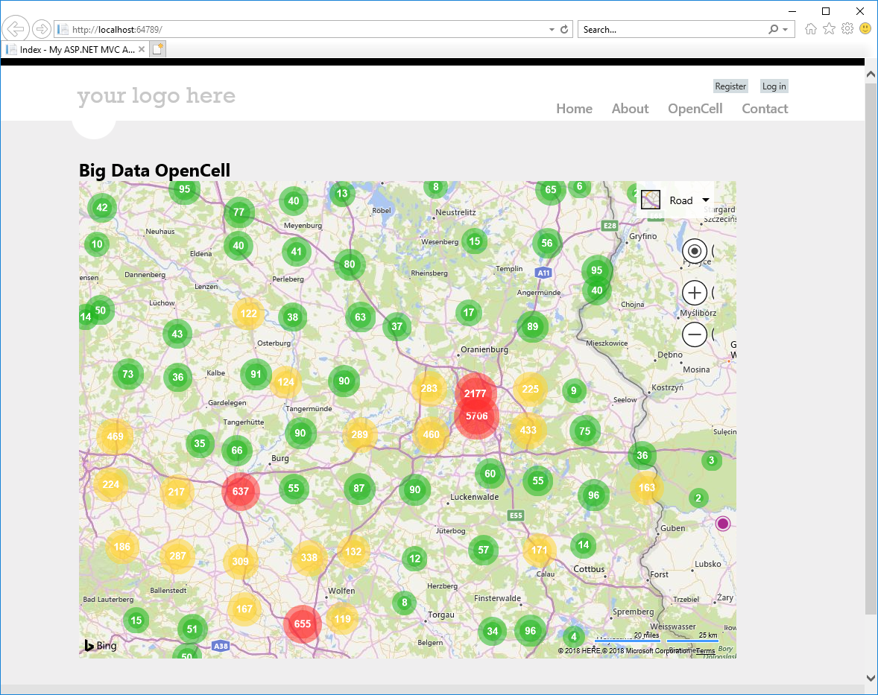
Germany : Largest cluster size “10020”
‘Oranienburg’ region
Largest cluster size “5706”
Germany Zoom Level : 4
Germany Zoom Level : 6

Slide 16
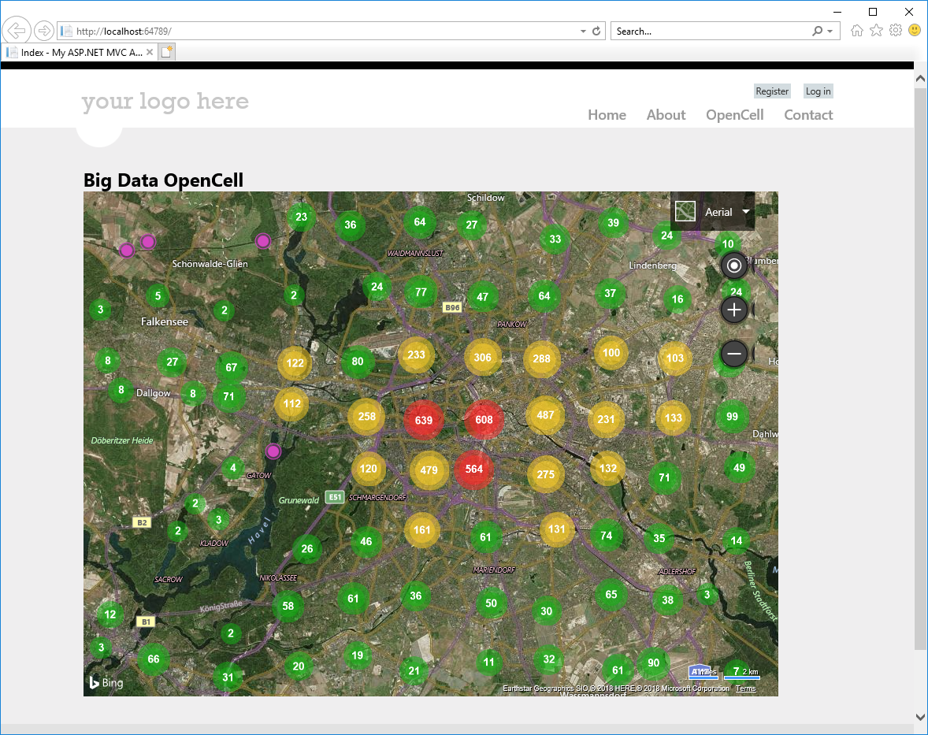
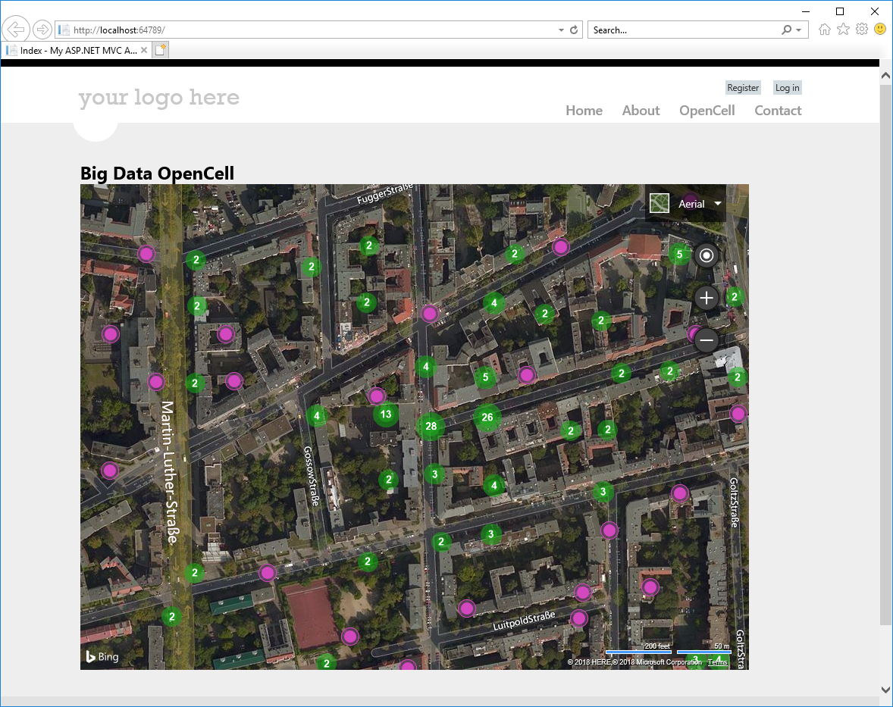
Dense Cluster in Wilmersdorf Area
Dense Cluster in Eisenacher StraBe “28” Measurements
Street View
City View

Slide 17
Thanks

